Slide 1
LOOPS IN C

Slide 2
FOR LOOP
The init step is executed first, and only once. This step allows you to declare and initialize any loop control variables. You are not required to put a statement here, as long as a semicolon appears.
Next, the condition is evaluated. If it is true, the body of the loop is executed. If it is false, the body of the loop does not execute and flow of control jumps to the next statement just after the for loop.
After the body of the for loop executes, the flow of control jumps back up to the increment statement. This statement allows you to update any loop control variables. This statement can be left blank, as long as a semicolon appears after the condition.
The condition is now evaluated again. If it is true, the loop executes and the process repeats itself (body of loop, then increment step, and then again condition). After the condition becomes false, the for loop terminates.

Slide 3
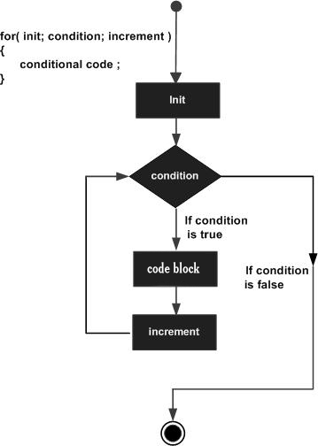
FLOW CHART
SYNTAX:
for ( init; condition; increment ) { statement(s); }

Slide 4
EXAMPLE
#include <stdio.h> int main () { int a; /* for loop execution */ for( a = 10; a < 20; a = a + 1 ) { printf("value of a: %d\n", a); } return 0; }

Slide 5
WHILE LOOP
The condition may be any expression, and true is any nonzero value. The loop iterates while the condition is true.
When the condition becomes false, program control passes to the line immediately following the loop.

Slide 6
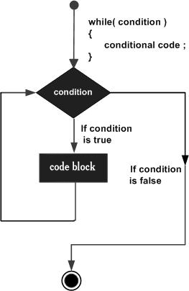
FLOW CHART
WHILE LOOP

Slide 7
EXAMPLE
#include <stdio.h>
int main ()
{ /* local variable definition */
int a = 10;
/* while loop execution */
while( a < 20 )
{ printf("value of a: %d\n", a);
a++;
}
return 0;
}

Slide 8
DO-WHILE
Unlike for and while loops, which test the loop condition at the top of the loop, the do...while loop in C programming language checks its condition at the bottom of the loop.
A do...while loop is similar to a while loop, except that a do...while loop is guaranteed to execute at least one time.
Syntax:
The syntax of a do...while loop in C programming language is:
do { statement(s); }while( condition );Notice that the conditional expression appears at the end of the loop, so the statement(s) in the loop execute once before the condition is tested.
If the condition is true, the flow of control jumps back up to do, and the statement(s) in the loop execute again. This process repeats until the given condition becomes false.

Slide 9
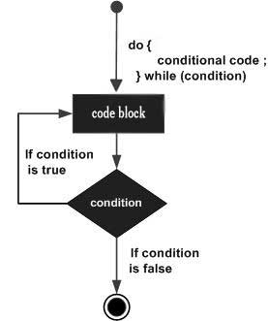
FLOW CHART
DO-WHILE :

Slide 10
EXAMPLE
#include <stdio.h>
int main ()
{ /* local variable definition */
int a = 10; /* do loop execution */
do
{
printf("value of a: %d\n", a);
a = a + 1;
}
while( a < 20 );
return 0;
}

Slide 11
NESTED LOOP
C programming language allows to use one loop inside another loop. Following section shows few examples to illustrate the concept.
The syntax for a nested for loop statement in C is as follows:
for ( init; condition; increment )
{
for ( init; condition; increment )
{
statement(s);
}
statement(s); }

Slide 12
EXAMPLE
#include <stdio.h>
int main ()
{ /* local variable definition */
int i, j;
for(i=2; i<100; i++)
{
for(j=2; j <= (i/j); j++)
if(!(i%j)) break; // if factor found, not prime
if(j > (i/j))
printf("%d is prime\n", i);
}
return 0;
}

Slide 13
SWITCH
A switch statement allows a variable to be tested for equality against a list of values. Each value is called a case
Syntax:
The syntax for a switch statement in C programming language is as follows:
switch(expression)
{ case constant-expression :
statement(s);
break; /* optional */
case constant-expression :
statement(s);
break; /* optional */
/* you can have any number of case statements */
default :
/* Optional */
statement(s);
}

Slide 14
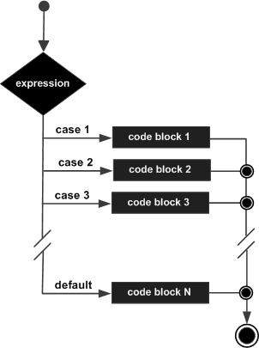
FLOW CHART
SWITCH CASE:

Slide 15
EXAMPLE#1
#include <stdio.h>
int main ()
{
/* local variable definition */
char grade = 'B';
switch(grade)
{
case 'A' :
printf("Excellent!\n" );
break;
case 'B' :
case 'C' :
printf("Well done\n" );
break;
case 'D' :
printf("You passed\n" );
break;
case 'F' :
printf("Better try again\n" );
break;
default : printf("Invalid grade\n" );
}
printf("Your grade is %c\n", grade );
return 0;
}

Slide 16
EXAMPLE#2
# include <stdio.h>
int main()
{
char o;
float num1,num2;
printf("Select an operator either + or - or * or / \n");
scanf("%c",&o);
printf("Enter two operands: ");
scanf("%f%f",&num1,&num2);
switch(o)
{
case '+':
printf("%.1f + %.1f = %.1f",num1, num2, num1+num2);
break;
case '-':
printf("%.1f - %.1f = %.1f",num1, num2, num1-num2);
break;
case '*':
printf("%.1f * %.1f = %.1f",num1, num2, num1*num2);
break;
case '/':
printf("%.1f / %.1f = %.1f",num1, num2, num1/num2);
break;
default: /* If operator is other than +, -, * or /, error message is shown */
printf("Error! operator is not correct");
break; }
return 0;
}

